Slide 1
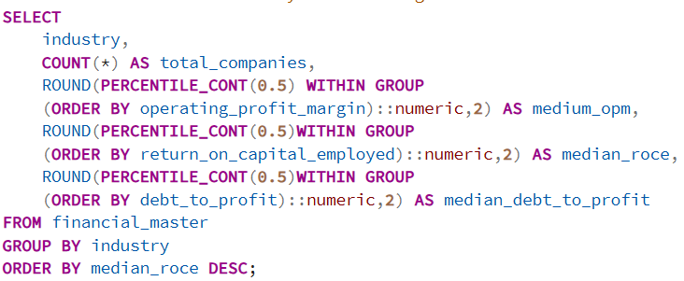
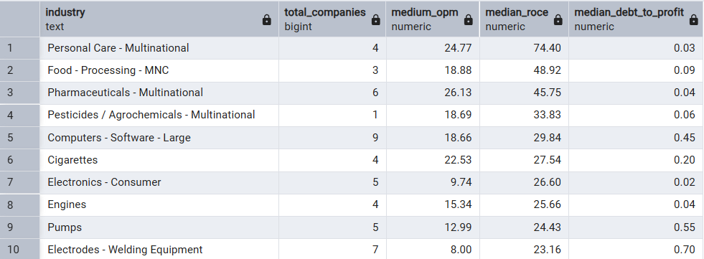
INDUSTRY-LEVEL INSIGHTS
Question: Which sector is fundamentally strongest based on Industry-wise Median OPM, ROCE, and Debt-to-Profit?
Query
Output
Recommendation:
Prioritize MNC Consumer and Pharma sectors for quality screening — combine with ROCE > 20 filter for stock selection
Avoid sectors with median OPM below 10 and debt-to-profit above 0.5 simultaneously
Follow up: Compare these medians against 3-year trend to confirm structural strength vs temporary improvement
Observation:
Personal Care - Multinational leads with highest median ROCE (~74) and strong OPM (~25), indicating premium pricing power
Food Processing and Pharmaceuticals follow closely — both show consistent margins above sector average
Most sectors show Debt-to-Profit below 1, suggesting broad deleveraging trend across Indian listed companies
Insight:
MNC-backed consumer sectors maintain superior margins due to brand moats and pricing power unavailable to domestic peers
Pharma and Food Processing benefit from inelastic demand — revenue stays stable regardless of economic cycles
Low debt-to-profit across sectors suggests post-COVID balance sheet cleanup has been largely successful

Slide 2
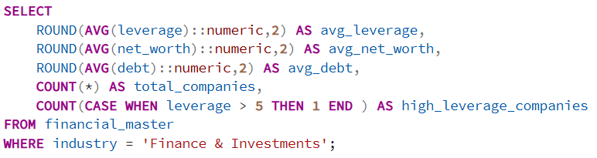
Question: Finance & Investments sector has 560 companies — what is their average leverage and net worth? How much NBFC risk exists?
Query
Output
Recommendation:
Isolate the 36 high-leverage companies for deeper solvency analysis — check interest coverage and NPA trends
Do not treat sector as homogeneous — segment into Banks, NBFCs, Insurance, and AMCs separately
Monitor RBI policy changes closely — rate hikes directly compress NBFC margins
Observation:
Sector average leverage stands at 2.46x with average net worth of ~₹2,147 Cr
Average debt of ₹3,453 Cr against 560 companies signals significant borrowing concentration
36 companies flagged as high leverage — roughly 6.4% of the sector
Insight:
Leverage of 2.46x is relatively moderate for financial services, but high variance likely exists between large NBFCs and small players
High-leverage subset (36 companies) poses systemic risk — these are potential stress points if interest rates rise or credit quality deteriorates
Large average debt suggests sector is dominated by a few large NBFCs pulling up the mean

Slide 3
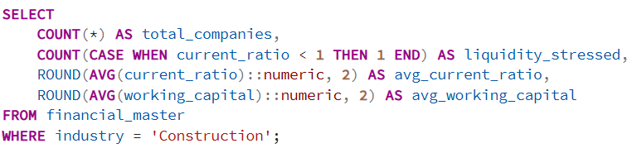

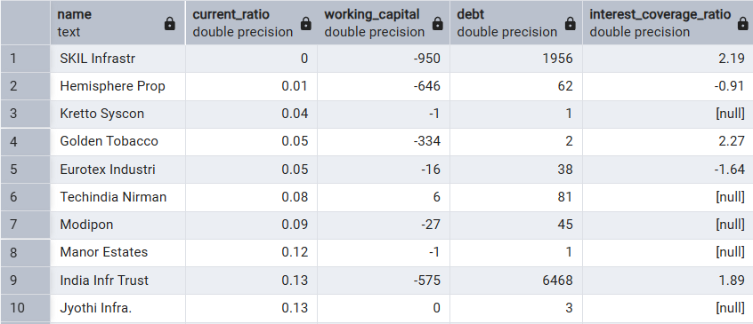
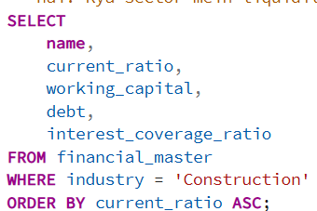
Question: Construction sector (323 companies) — how is working capital and current ratio? Is there liquidity stress?
Query
Output
Output
Query
Observation:
65 out of 323 companies are liquidity stressed — nearly 20% of the sector
Average current ratio of 13.68 seems inflated — individual company data shows SKIL Infrasture at 0, Hemisphere Prop and others with negative working capital
Several companies show negative working capital alongside high debt and null interest coverage
Recommendation:
Avoid construction companies with current ratio below 0.5 and negative working capital simultaneously
Flag companies with null interest coverage for exclusion from any investment screener
Cross-check against NCLT/IBC filings — several names here may already be under insolvency proceedings
Insight:
Construction sector structurally suffers from long payment cycles — clients delay payments while material costs are upfront
Null interest coverage in multiple companies suggests these firms cannot service debt from operations — survival depends on refinancing
Negative working capital combined with high debt is a classic pre-default pattern in infrastructure companies

